Slide 1
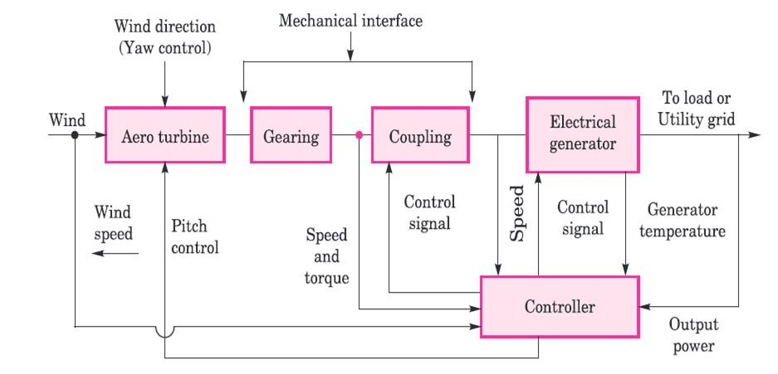
BASIC COMPONENTS OF WIND ENERGY CONVERSION SYSTEM (WECS)
A wind energy conversion system converts wind energy into some form of electrical energy.

Slide 2
BASIC COMPONENTS OF WIND ENERGY CONVERSION SYSTEM (WECS)
Main power flow
Aero turbine: Wind acts on the rotor blades of the aero turbine, converting wind kinetic energy into rotary mechanical energy (shaft torque and speed).​
Gearing: A gearbox increases the low‑speed, high‑torque rotation from the turbine to a higher speed suitable for the generator.​
Coupling: A mechanical coupling transmits the geared torque and speed to the electrical generator while accommodating minor misalignments and mechanical interface constraints.​
Electrical generator: The generator converts incoming mechanical power into electrical power that is supplied to the load or utility grid.

Slide 3
BASIC COMPONENTS OF WIND ENERGY CONVERSION SYSTEM (WECS)
Sensing and feedback paths
Wind speed and direction: Wind speed is measured and fed to the controller; wind direction is used for yaw control so that the turbine faces the wind for maximum capture.​
Speed and torque: Shaft speed and torque at the mechanical interface are sensed and sent to the controller to regulate operating point and protect against overspeed or overload.​
Generator variables: Generator speed, electrical output power, and temperature are monitored and fed back to the controller for power regulation and thermal protection.

Slide 4
BASIC COMPONENTS OF WIND ENERGY CONVERSION SYSTEM (WECS)
Control actions
Pitch control: The controller adjusts blade pitch angle to control captured power and rotor speed, limiting output in high winds and optimizing energy capture in normal winds.​
Yaw control: The controller sends commands to the yaw drive so the nacelle (and thus the aero turbine) rotates about the tower axis to align with changing wind direction.​
Coupling and generator control: Control signals to the coupling or drive train and generator (often via power electronics in practical systems) maintain desired speed, torque, and electrical output characteristics.

Slide 5
BASIC COMPONENTS OF WIND ENERGY CONVERSION SYSTEM (WECS)
Role of the controller
The controller acts as the brain of the WECS, processing sensor signals (wind speed, direction, shaft speed/torque, generator power and temperature) and issuing control signals for pitch, yaw, and generator operation.​
It ensures safe and efficient operation by optimizing power extraction under normal conditions and initiating protective actions (pitching out, yawing, braking or shutdown) during extreme wind or fault conditions.

Slide 6
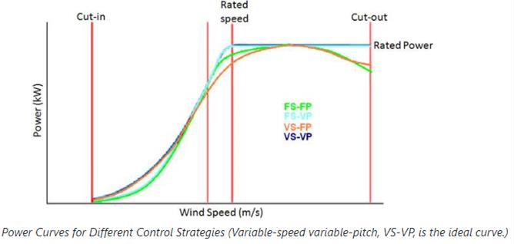
WECS based on the rotational speed of turbines

Slide 7
WECS based on the rotational speed of turbines
Output power can be adjusted by controlling the pitch of the blade and speed of the generator
Rotational speed of turbine can be controlled by
Fixed-speed Fixed-pitch
Fixed-speed Variable-pitch
Variable-speed Fixed-pitch
Variable-speed Variable-pitch

Slide 8
WECS based on the rotational speed of turbines
Fixed-speed fixed-pitch (FS-FP)
In this design, the turbine’s generator is directly coupled to the power grid, causing the generator speed to lock to the power line frequency and fix the rotational speed.
In this configuration performance cannot be improved with active control.
These turbines are regulated using passive stall methods at high wind speeds.
From the figure, it is seen that the actual power does not match the ideal power, implying that there is lower energy capture.
Turbine operates at maximum efficiency only at one wind speed in the low-speed region
The rated power of the turbine is achieved only at one wind speed (poor power regulation)

Slide 9
WECS based on the rotational speed of turbines
2. Fixed-speed variable-pitch (FS-VP)
This configuration operates at a fixed pitch angle below the rated wind speed and continuously adjusts the angle above the rated wind speed
fixed-speed operation implies a maximum output power at one wind speed.
Below the rated wind speed, the FS-VP turbine has a near optimum efficiency
Exceeding the rated wind speed, the pitch angles are continuously changed, providing little to no loss in power.

Slide 10
WECS based on the rotational speed of turbines
3. Variable-speed fixed-pitch (VS-FP)
Continuously adjusts the rotor speed relative to the wind speed by controlling the synchronous speed of the generator.
Fixed-pitch relies heavily on the blade design to limit power through passive stalling.
power efficiency is maximized at low wind speeds, and rated turbine power is attained only at one wind speed.
In lower wind speed cases, VS-FP can capture more energy and improve power quality.

Slide 11
WECS based on the rotational speed of turbines
4. Variable-speed variable-pitch (VS-VP)
It is a derivation of VS-FP and FS-VP.
Below the rated wind speed, VS-FP is used to maximize energy capture and increase power quality.
Above the rated wind speed, FS-VP permit efficient power regulation at the rated power.
VS-VP is the only control strategy that theoretically achieves the ideal power curve

